Slide 1
Review Sprint 3 PIVOANE PIéton, Vitesse, dOs d’ANE
OUR TEAM
Sara Bassanetti
Emeline Delhay
Luiz Renato Rodrigues Carneiro
Léa Scheer
Yuchen Xia
TUTORS
Gwendolyne Le Corre
Thierry Monteil
Notes:
Hello,
My name is Luiz Renato …
Our tutors are Gwendolyne Le Corre and Thierry Monteil
This is the presentation of the review 0 with our project plan of the autonomous vehicle project. The name of our project is PIVOANE due to the translation of the words pedestrian, speed, and speed bump in french.

Slide 2






TABLE OF CONTENT
1
3
5
PRODUCT DESCRIPTION
STORIES /
DEMONSTRATIONS
SCHEDULE CONTROL
OBJECTIVES OF SPRINT 3
ORGANISATION OF SPRINT 3
OBJECTIVES / ORGANIZATION OF SPRINT 4
2
2
4
6

Slide 3


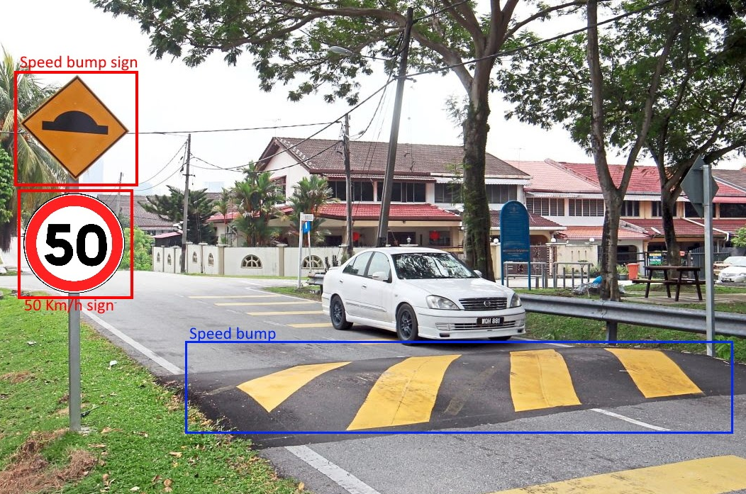

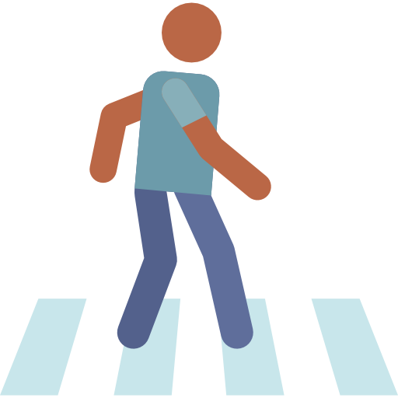
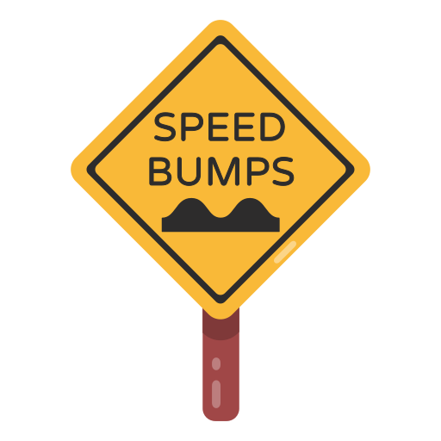


PRODUCT DESCRIPTION
Adapt the car's behavior according to the environment detected in different complex situations
Adjust the speed of the car when a road sign is detected
Stop the car when there are pedestrians on the road
Slow down when approaching a crosswalk or speed bump
3

Slide 4




OBJECTIVES OF SPRINT 3
Car behavior implementation
Implement previously defined behaviors
New road signs detection
Find and add other datasets for speed limits and speed bump
Link Camera detection to car behavior
Ensure communication between Jetson and Raspberry without computer
4
4

Slide 5











Object Detection with ROS
Yolo on ROS
Use Darknet Yolo framework for object detection
Docker container for to set the GPU configuration
New architecture with three ROS
5
5
Notes:
The first user story we had to achieve was the detection of obstacles on the road using ultrasonic sensors. I worked on it with Emeline. Since we wanted mostly to detect a pedestrian crossing the road, we took an obstacle with a width of approximately 20 centimeters. We defined the values for the test such as when the car detects an obstacle on the road, it drives forward at full speed until it sees it at 1 meter. *** activate the animation *** Once the car is at one meter of the obstacle, it drives half speed until it reaches a distance of 50centimeters . Then it stops. I am going to show you now with a demonstration. ***end of demonstration *** The main use of the ultrasonic sensors is to detect last second pedestrians and obstacles, such as a kid running in front of the car or animals. We can improve this user story by adding the LIDAR detection since it is a lot more precise. This is something we might work on during a future sprint.

Slide 6






STORIES / DEMONSTRATIONS
Road signs detection
Place a road signs in front of the car
Identify our road signs.
30 speed
Stop
50 speed
bump
6
6
Notes:
The first user story we had to achieve was the detection of obstacles on the road using ultrasonic sensors. I worked on it with Emeline. Since we wanted mostly to detect a pedestrian crossing the road, we took an obstacle with a width of approximately 20 centimeters. We defined the values for the test such as when the car detects an obstacle on the road, it drives forward at full speed until it sees it at 1 meter. *** activate the animation *** Once the car is at one meter of the obstacle, it drives half speed until it reaches a distance of 50centimeters . Then it stops. I am going to show you now with a demonstration. ***end of demonstration *** The main use of the ultrasonic sensors is to detect last second pedestrians and obstacles, such as a kid running in front of the car or animals. We can improve this user story by adding the LIDAR detection since it is a lot more precise. This is something we might work on during a future sprint.

Slide 7
STORIES / DEMONSTRATIONS
Class | mAP [%]
Pedestrian | 86.33
Stop Sign | 99.72
50 km/h | 59.29
30 km/h | 67.37
Speed bump | 99.7
7
7
Notes:
The first user story we had to achieve was the detection of obstacles on the road using ultrasonic sensors. I worked on it with Emeline. Since we wanted mostly to detect a pedestrian crossing the road, we took an obstacle with a width of approximately 20 centimeters. We defined the values for the test such as when the car detects an obstacle on the road, it drives forward at full speed until it sees it at 1 meter. *** activate the animation *** Once the car is at one meter of the obstacle, it drives half speed until it reaches a distance of 50centimeters . Then it stops. I am going to show you now with a demonstration. ***end of demonstration *** The main use of the ultrasonic sensors is to detect last second pedestrians and obstacles, such as a kid running in front of the car or animals. We can improve this user story by adding the LIDAR detection since it is a lot more precise. This is something we might work on during a future sprint.

Slide 8

STATE MACHINE
back to previous state when (Timer 2s == true)
Speed
30
Move
(rpm 36)
stop
Speed 50
Speed 50
mode auto
stop
STOP
(highest priority)
Move
(rpm 60)
Idle
Speed
bump
Speed
bump
Slow Down
(rpm 30)
Pedestrian
Pedestrian gone
8
Notes:
In order to be very clear about the behavior of the car, we decided to implement a state machine. This way, we would be very clear on the code to develop. As you can see, the very first state is idle which means the car isn’t doing anything. Then, we activate the autonomous mode which makes the car to move at full speed. If the car detects a speed sign 30 then it halfs its speed. If a stop is detected, the car stops for 2s and then recovers the previous speed. If a speed bump is detected, the car slows down for 2s and then recovers its previous speed. In yellow you can see the transition if a pedestrian gets in the way of the car, then the car stops until the pedestrian is gone. This is the same behavior whatever the previous state is, I just didn’t put long arrows so that the state machine stays quite clear to read. For now, if two panels are detected at the same time, the road sign kept in memory is the nearest one.
Now I am going to show you in animations the behavior of the car according to the road sign detected. What we managed to do is to send a distance to the car at which the road sign is located and then the car calculate the distance it has already travelled since the detection of the road sign. Once the total distance has been covered, the car adopts the correct behavior.

Slide 9



STORIES / DEMONSTRATIONS
Car behavior according to road sign :
STOP
Idle
mode auto
Timer 2s
Move
(rpm 60)
STOP
STOP sign
detect : stop
2m
2s
9
9
Notes:
In the animation, you will see the real evolution of the car, the moment it detects a road sign and the evolution of the state machine accordingly. For the stop sign, if the car is moving at full speed and the stop sign is detected, when it reaches the panel, the car stops for 2 seconds and recover the full speed. CLIC

Slide 10
STORIES / DEMONSTRATIONS
Car behavior according to road sign :
30
Move (rpm 60)
Move
(rpm 36)
Road sign 30
detect : 30
2m
10
10
Notes:
Now for the 30-road sign, if the car is at full speed and detects it, when reaching the panel, the car adopts the right speed. Now, we will show you the evolution of the behavior according to those road sign; first the stop on the ground and then all of them in a row on a stool.

Slide 11
STORIES / DEMONSTRATIONS
Car behavior according to road sign :
50
Move (rpm 36)
Move
(rpm 60)
Road sign 50
detect : 50
2m
11
11
11
Notes:
Since the publishing of the topics is quite long, for the two last road signs we will show you the behavior in the room with the car on a stool.

Slide 12
STORIES / DEMONSTRATIONS
Car behavior according to road sign : SPEED BUMP
Idle
mode auto
Timer 2s
Move
(rpm 60)
Slow down
detect : speed bump
Speed bump
1m
2s
12
12

Slide 13
ORGANIZATION OF SPRINT 3
NOVEMBER / DECEMBER
​29 | 30 | 1 | 2 | 3 | 4 | 5 | 3 | 4 | 8
9​ | 10 | 11 | 12 | 13
First week
Second week
Implementing behavior
Distances’ calculation
Merge distance + behavior
Create new datasets
AI training
AI Ros node
Task difficulty
13
13
Notes:
Let talk about the task organization of this sprint. As usual, we divided the tasks in two groups with the AI part and the automation part. Lea an Emeline worked on the automation part with the 3 first tasks in this diagram. They begin to work on implementing behavior of the car according to different complex situations. They worked on this one first because there is the most difficult part of the sprint for them. They worked also on calculate the distance that the car travel and when these two tasks were achieved they linked the both. It means the car behaves as we want when we want, at the level of the sign on the road.
Yuchen Luiz and I worked on the AI part with the 3 last tasks you can see. We start with creating our dataset because it was the longest tasks of the sprint. We trained the AI model just after that. We also implement the AI ros node and try to link camera detection and behavior of the car.

Slide 14


SCHEDULE CONTROL
DONE
• Train AI Model with new road sign datasets
• Road sign detection using new AI models
• Implement car behavior using state machines
PLANNED
• Train AI Model with new road sign datasets
• Road sign detection using new AI models
• Implement car behavior using state machines
• Link camera to car behavior
PLANNED BUT NOT DONE
• Fully linking Camera detection to car behavior
14
14
Notes:
So, there is our schedule control. As you can see, we planned for this sprint to train AI model on new road signs and to detect them. We also planned to implement car's behavior using state machine and to link the camera detection with the behavior.
We succeed to achieve the 3 first points. Indeed, we are able to detect and make the difference with 4 types of road signs and pedestrian using the camera. We are also able to control the car in different complex situations.
Unfortunately, we still have some issues to link completely the camera and the behavior of the car. We have 2 nodes, one for the AI part and one controlling the behavior of the car but for the moment the AI node is not sending all the data we need to link camera detection and the right behavior of the car. So we planned to achieve this for the next sprint and Emeline will explain that to you later.

Slide 15
15
15
Notes:
As we are already on the third sprint, we did this amazing velocity chart to make a synthesis about the tasks we complete during our previous sprints. This diagram will helps us to plan the tasks to achieve for the next sprints.
To make it, we gave note of each tasks with the difficulty of the task and with the time we spend to achieve it. So you can see in blue what we planned to do during the sprint and in dark green what we really did. We can explain more precisely these result after if you want.
And now I'll let Emeline present you the objective of our sprint 4.

Slide 16


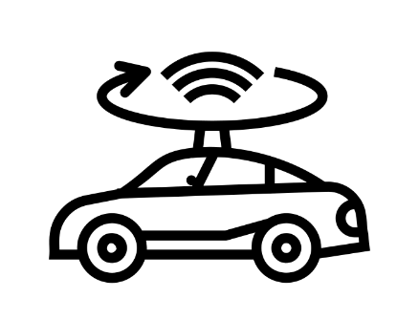
OBJECTIVES OF SPRINT 4
Finish linking camera to Rasperry Pi
Ensure working link, with readable data
Optimisation of datasets
Increase the diversity of data
Lidar detection
Detect obstacles using the Lidar
16
16
Notes:
For sprint 3, we have 3 main goals. First, we want to implement the car behavior Lea talked about earlier so that we can simulate the car reaction to each road sign.
We will also work on detecting new road signs, and improving the datasets.
Finally, we want our camera detection to communicate directly with the car without using our PC

Slide 17

OBJECTIVES OF SPRINT 4
User Story 1: Link camera to Raspberry Pi
Determine distance between Camera and road sign at detection time
Create a real environment outside with our road signs
Filter and select data
17
17
Notes:
As a second user story, Yuchen and Sarah will work on improving our road sign detection. To do so, they will look for new datasets to include new road signs such as the speed bump one. They will also improve our already started AI model for speed signs, which does not work with the wanted accuracy. Given our AI model were not trained on the same dataset, we will then ensure there is no road sign mix up.
At the end of the sprint, we want to have a 95% accuracy, and we will test the good detection in the same way we did today with the stop sign and verifying the car behavior is the good one.

Slide 18



OBJECTIVES OF SPRINT 4
User Story 2: Optimisation of datasets
Add more samples to the dataset to increase sample diversity (size, color, clarity, etc.)
Increased accuracy of detection in complex situations with mixed road signs and pedestrians
Train AI model
18
18
Notes:
As a second user story, Yuchen and Sarah will work on improving our road sign detection. To do so, they will look for new datasets to include new road signs such as the speed bump one. They will also improve our already started AI model for speed signs, which does not work with the wanted accuracy. Given our AI model were not trained on the same dataset, we will then ensure there is no road sign mix up.
At the end of the sprint, we want to have a 95% accuracy, and we will test the good detection in the same way we did today with the stop sign and verifying the car behavior is the good one.

Slide 19
OBJECTIVES OF SPRINT 4
User Story 3: Lidar Detection
Detect moving obstacles
React accordingly
Determine the obstacle’s speed
19
19

Slide 20



TEST OF USER STORIES
Detect obstacles 5 meters away in front of the car, and identify it in 2 seconds
Stop at 50 centimeters from the obstacle
React at sign level
Detect every road sign
20
20

Slide 21
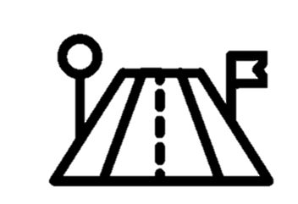

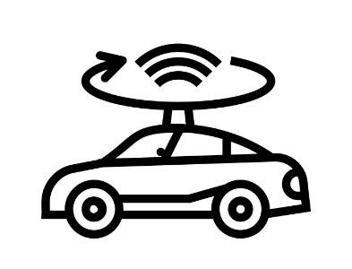
SUMMARY
Sprint 3:
Sprint 4:
Finish link between camera and Raspberry Pi
Adapt car behavior
New road signs detection
Improve AI model
Link camera detection and behavior
Detect obstacles with Lidar
21
21
Notes:
So, to sum up the matter, during this sprint we succeeded in creating our first AI model and training it with stop sign and pedestrians. We also used ultrasonic sensors to detect additional pedestrians. Finally, we planned our entire car behavior by taking in account multiple scenarios.
For the next sprint, we will implement this behavior, add new sign detection, and link the camera detection with the car behavior.

